Slide 1

DEPARTMENT OF COMPUTER SCIENCE AND ENGINEERING
SOA PROJECT REVIEW – 1
SkillGrow – Student Skill Development & Progress Tracking Platform
PROJECT TEAM
P Akhil Kumar Reddy — 2420030496
G Rohan Chowdary — 2420030564
K. Sai Pranav Reddy — 2420030224
Guide: Venkateswari Ketineni
Course: SOA Programming and Microservices – (24SDCS03)
27 August 2026

Slide 2

Outline of Project Work
01
Introduction
02
Problem Statement
Why SkillGrow is needed
Current student skill-tracking gap
03
Objectives
04
Literature / Existing Context
What the platform aims to achieve
Limitations addressed by SkillGrow
05
Problem Gap Identification
06
Innovation & Novelty
From fragmented tracking to unified guidance
Integrated full-stack + ML approach
07
Architecture
08
Feasibility & Project Plan
React → Spring Boot → ML → MySQL
Proposed implementation phases
A.Y. 2026–2027
SOA Programming and Microservices
Review–1 | 2

Slide 3
Problem Statement
Students often lack a single place to record coursework, projects, certifications and skill milestones. This creates fragmented self-assessment, limited visibility into progress, and slower skill development.
Fragmented Records
Coursework, projects and certifications are maintained in different places.
Poor Progress Visibility
Students need clearer tracking of milestones and growth over time.
Limited Guidance
Students need tailored recommendations on what to learn next.
SkillGrow addresses this through a unified dashboard with structured learning paths and recommendations.
A.Y. 2026–2027
SOA Programming and Microservices
Review–1 | 3

Slide 4
Objectives
01
Unified Skill Tracking
Record skill milestones, coursework, projects and certifications in one platform.
02
Progress Monitoring
Visualize skill growth and monitor progress against structured learning paths.
03
Personalized Recommendations
Use activity and skill history to recommend relevant resources and next steps.
04
Secure Role-Based Access
Protect student data with JWT authentication and access for students, mentors and administrators.
05
Scalable Architecture
Use React, Spring Boot REST APIs, Python ML, MySQL and Docker for a maintainable system.
A.Y. 2026–2027
SOA Programming and Microservices
Review–1 | 4

Slide 5
Literature / Existing Context
The project abstract identifies the following limitations in the current student skill-development experience.
Current Need
Observed Limitation
SkillGrow Response
Expected Benefit
Skill records
Coursework, projects and certifications can be fragmented.
Unified dashboard
Single source of progress data
Progress tracking
Self-assessment may not show growth clearly over time.
Milestones + learning paths
Clearer growth visibility
Next-step guidance
Students may not know which skills/resources to pursue next.
Python ML recommendations
Tailored learning direction
Note: This slide is derived from the supplied project abstract; no external papers were provided.
A.Y. 2026–2027
SOA Programming and Microservices
Review–1 | 5

Slide 6
Problem Gap Identification
CURRENT GAP
PROPOSED SOLUTION
Scattered information
→
Unified student profile
Manual self-assessment
→
Structured skill milestones
Limited progress visibility
→
Dashboard-based tracking
Generic learning direction
→
ML-driven recommendations
Core gap: connecting skill data, progress tracking and personalized recommendations in one secure platform.
A.Y. 2026–2027
SOA Programming and Microservices
Review–1 | 6

Slide 7
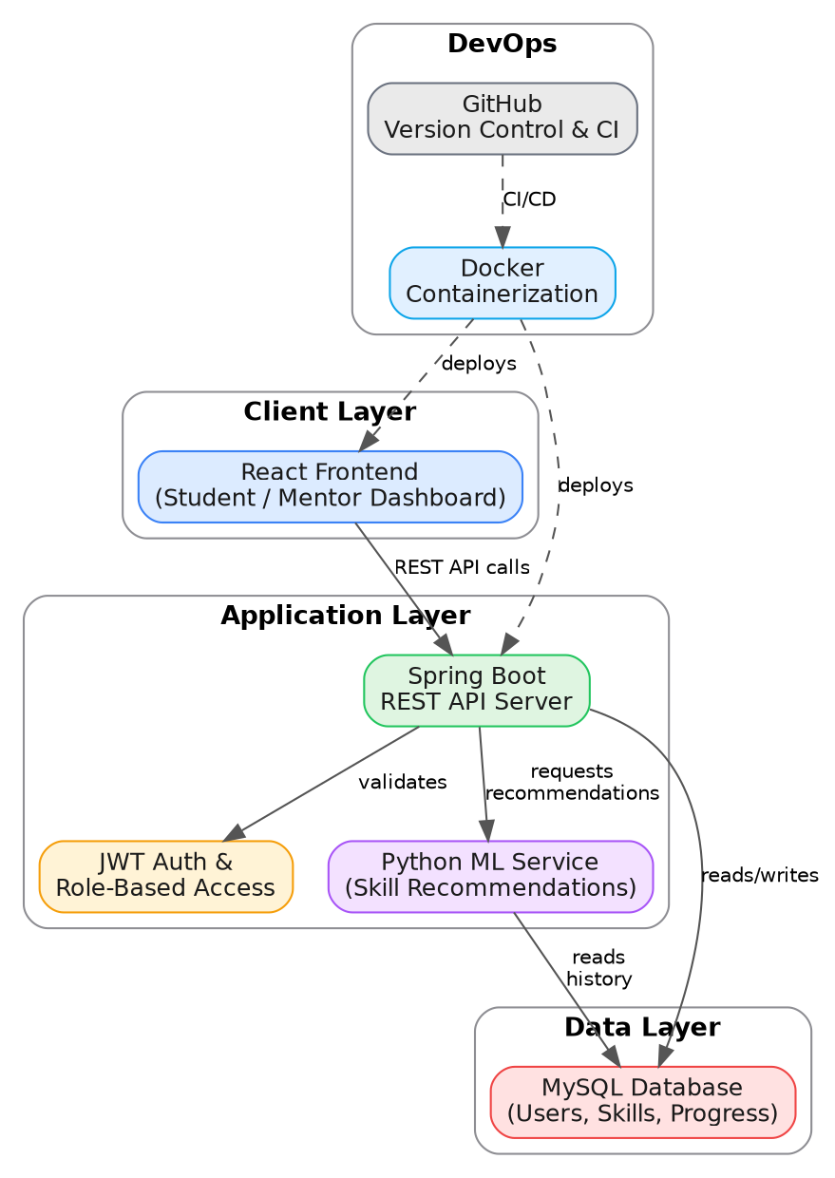
Innovation, Creativity, and Novelty
Integrated Skill Intelligence
Combines structured tracking with ML-based next-step recommendations.
PROPOSED SYSTEM ARCHITECTURE
Service-Oriented Design
React client communicates with a Spring Boot REST service layer.
Secure & Deployable
JWT role-based access, MySQL persistence and Docker-based deployment.
Architecture reproduced from the supplied project abstract (page 2).
A.Y. 2026–2027
SOA Programming and Microservices
Review–1 | 7

Slide 8
Feasibility and Project Plan
The proposed stack is feasible using established technologies and a modular service architecture.
Technical
React + Spring Boot + Python ML + MySQL + Docker
Operational
Role-based dashboards for students, mentors and administrators
Scalability
REST services and containerization support future expansion
PROPOSED 12-WEEK IMPLEMENTATION TIMELINE
W1
W2
W3
W4
W5
W6
W7
W8
W9
W10
W11
W12
Requirements & Design
React Frontend
Spring Boot + REST APIs
Python ML Recommendations
Integration & Testing
Docker + Evaluation
Timeline is a proposed project plan for review purposes and was not specified in the supplied abstract.
A.Y. 2026–2027
SOA Programming and Microservices
Review–1 | 8

